Slide 1


Slide 2








EPIC GAMES CAMPAIGN SNAPSHOT
Generic, GTAV, Civilization VI, Borderlands & Ark
3.8 MM
impressions
1.9 MM
accounts reached*
2.0 MM
views
53.5 K
engagements
34.3 K
clicks
 | VTR: 105.45%** |  | VTR: 77.77% CTR: 3.36% |  | VTR: 26.27% CTR: 1.74% |  | VTR: 32.17% |  | CTR: 0.26%
Pre-Roll
IGTV
Stories
**YT reports only impressions on YT and many of views came from Google Search and WhatsApp, that’s why VTR > 100%.
Source: Facebook & Instagram Studio./ YouTube Analytics / FreeWheell and Google Ad Manager. *Reach may be duplicated between campaign and social network.

Slide 3
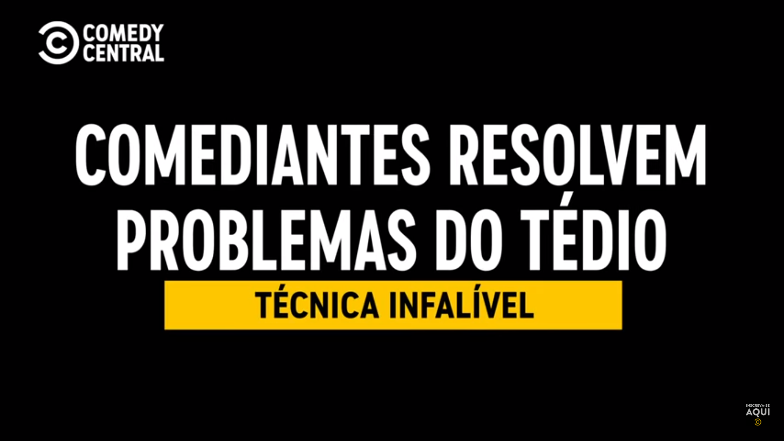
GENERIC
YT, FB, IGTV: Comediantes Resuelven el Aburrimiento
YT Pre-Roll Unskippable: Short format Comediantes Resuelven el Aburrimiento
total
 | impressions | reach* | views | engagement | clicks
 | 11% 22% from YT recommending content 21% from recommendation on homepage | 11% | 1% 73% of average percentage viewed | 29% 1,620 likes & 94 shares | -
 | 73% | - | 91% | - | 99.7%
 | 7% | 89% | 4% | 16% | 0.3%
 | 9% | - | 4% | 55% | -
impressions
1.6 M
VTR: 8.6%
reach*
122 K
Pre-Roll
views
999.5 K
VTR: 77.8%
CTR: 2.61%
engagement
6.2 K
VTR: 29.5%
CTR: 0.08%
clicks
30.6 K
IGTV
VTR: 27.8%
Source: Facebook & Instagram Studio./ YouTube Analytics / Free Wheell and Google Ad Manager. *Reach may be duplicated between social network.

Slide 4

GTAV
YT, FB & IGTV: "Funny capsule" Game 1 | Grand Theft Auto V”
IG Stories: Call to Action Game 1 |GTAV and MTV SELFIE NEWS Stories GTAV
total
 | impressions | reach* | views | engagement | clicks
 | 19% 42% from YouTube recommending content | 8% | 29% 77% of average percentage viewed | 7% 1,100 likes & 88 shares | -
 | 19% | 22% | 23% 26K minutes viewed | 37% 1,585 clicks to play, 671 likes & 34 loves | 31%
 | 35% | 39% | 47% | 49% 7,223 likes & 1,099 directs | -
 | 28% | 32% | - | 8% | 69%
impressions
617 K
VTR: 37.1%
reach*
503.7 K
VTR: 29.2%
CTR: 0.30%
views
146.3 K
IGTV
engagement
18.3 K
VTR: 32.5%
clicks
1.093
Stories
CTR: 0.44%
Source: Facebook & Instagram Studio./ YouTube Analytics. *Reach may be duplicated between social network.

Slide 5
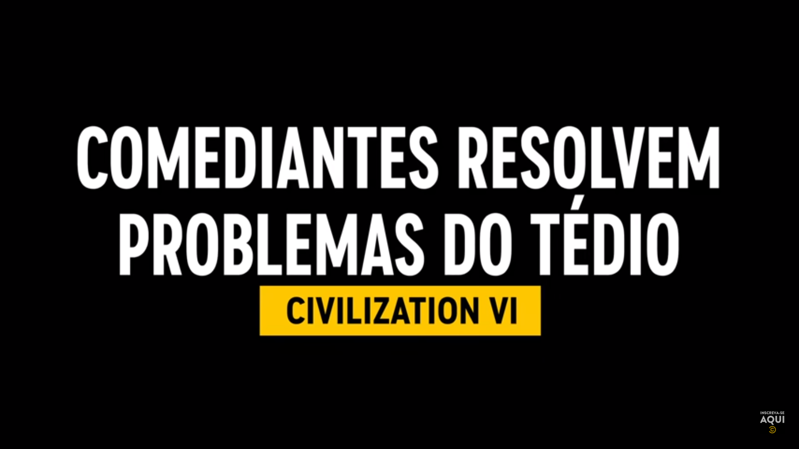
CIVILIZATION VI
YT, FB & IGTV: "Funny capsule" Game 2 | Civilization VI”
IG Stories: Call to Action Game 2 |CIV VI | Stories Frame 1 and MTV SELFIE NEWS Stories CIV VI Frame 1-4
total
 | impressions | reach* | views | engagement | clicks
 | 19% 87% from viewers seeking the content | 18% | 63% 72% of average percentage viewed | 12% 1,180 likes & 98 shares | -
 | 19% | 17% | 12% 15.6K minutes viewed | 28% 1,585 clicks to play, 351 likes & 21 loves | 35%
 | 23% | 24% | 24% | 49% 4.699 likes & 377 directs | -
 | 41% | 41% | - | 11% | 65%
impressions
625.8 K
VTR: 97.9%
reach*
572.2 K
VTR: 20.9%
CTR: 0.28%
views
182.3 K
IGTV
engagement
10.5 K
VTR: 30.9%
clicks
828
Stories
CTR: 0.21%
Source: Facebook & Instagram Studio./ YouTube Analytics. *Reach may be duplicated between social network.

Slide 6

BORDERLANDS
YT, FB & IGTV: "Funny Capsule Game 3 | Borderlands”
IG Stories: Call to Action Game 3 | Borderlands and MTV Selfie News Stories Borderlands
total
 | impressions | reach* | views | engagement | clicks
 | 23% 88% from viewers seeking the content | 60% | 75% 84% of average percentage viewed | 5% 533 likes & 29 shares | -
 | 12% | 16% | 3% 9K minutes viewed | 19% 1,585 clicks to play, 351 likes & 15 loves | 92%
 | 49% | - | 21% | 72% 8.278 likes & 105 comments | -
 | 16% | 24% | - | 4% | 8%
impressions
472.9 K
VTR: 266.1%
reach*
318.8 K
VTR: 26.3%
CTR: 2.60%
views
389 K
IGTV
engagement
11.6 K
VTR: 35.8%
clicks
1.559
Stories
CTR: 0.16%
Source: Facebook & Instagram Studio./ YouTube Analytics. *Reach may be duplicated between social network.

Slide 7
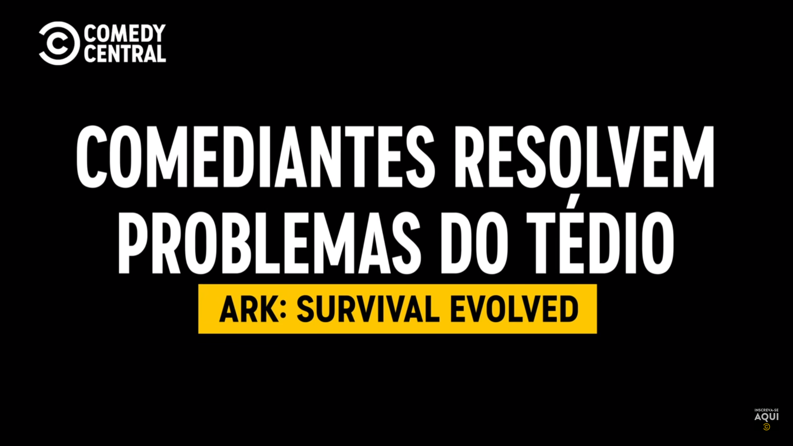
ARK
YT, FB & IGTV: ""Funny capsule" Game 4 | ARK”
IG Stories: Call to Action Game 1 |GTAV | Stories Frame 1 and MTV SELFIE NEWS Stories ARK
total
 | impressions | reach* | views | engagement | clicks
 | 33% 80% from viewers seeking the content | 55% | 79% 83% of average percentage viewed | 28% 1.820 likes & 41 shares | -
 | 17% | 20% | 6% | 4% | 15%
 | 30% | - | 14% | 60% 4.054 likes & 31 comments | -
 | 20% | 25% | - | 7% | 85%
impressions
501.5 K
VTR: 154.5%
reach*
392.4 K
VTR: 24%
CTR: 0.032%
views
323.5 K
IGTV
engagement
6.8 K
VTR: 31.5%
clicks
180
Stories
CTR: 0.15%
Source: Facebook & Instagram Studio./ YouTube Analytics. *Reach may be duplicated between social network.

Slide 8
Glossary
METRIC | DEFINITION
IMPRESSIONS | Facebook: Number of times a post is displayed. IG Stories & IGTV: Number of times the post/ stories has been viewed for at least 1 second. For stories, one impression can count as one view. YouTube: Number of times your video thumbnails were shown to viewers. Includes only impressions on YouTube, not on external sites or apps.
REACH | Facebook, IG Stories, IGTV & YouTube: Number of unique accounts viewed your post. In YouTube the metric’s name is unique viewers.
VIEWS | Facebook & IGTV: Number of times a video has been viewed for at least 3 seconds. YouTube: Number of times a video has been viewed for at least 30 seconds.
ENGAGEMENT | Facebook: Reactions, Comments, Shares & Post Clicks. IG Stories: Interactions (Links clicks, profile visits, website clicks, sticker taps). IGTV: Likes, comments, saved and direct message. YouTube: Likes, dislikes, shares and comments
CLICKS | Facebook, IG Stories & YouTube Pre-Roll: Number of link clicks.
VTR% | Facebook, IGTV & YouTube: % of total views over the number of impressions. YouTube Pre-Roll: % of completed views over the number of impressions.
CTR% | Facebook: % of clicks over total views. IG Stories: % of clicks over impressions. YouTube Pre-Roll: % of clicks over total complete views.

